Slide 1
Modeling COVID-19 infection dynamics and mitigation strategies for in-person K-6 instruction
Douglas Ezra Morrison
Department of Public Health Sciences
UC Davis School of Medicine
November 14, 2025
Notes:
Hi everyone, good to meet you.
How many 1st years? How many 2nd years? How many are in 3rd year and beyond?
I’m going to talk about an agent-based model that we developed in order to help the Los Angeles Unified School District start planning a safe return to school during the covid pandemic.

Slide 2
Background: Impacts of School Closures
Harms to students
  Educational progress
  Psychosocial development
  Mental and physical health
Harms to families
  Increased childcare, educational burdens
Cascading economic impacts on workplaces
Disparities exacerbated
  Students most harmed by closures are often also in communities with high COVID-19 burden.
Notes:
As I’m sure you’re aware, school closures due to COVID19 caused substantial disruptions to students’ educations, as well as to their social development and health.
Closures have also increased burdens on families due to the need for increased childcare and educational support, and there are economic ripple effects.
These problems have been particularly severe for students who were already disadvantaged due to socioeconomic factors, because these students often have less resources and support to help make distance learning successful.

Slide 3
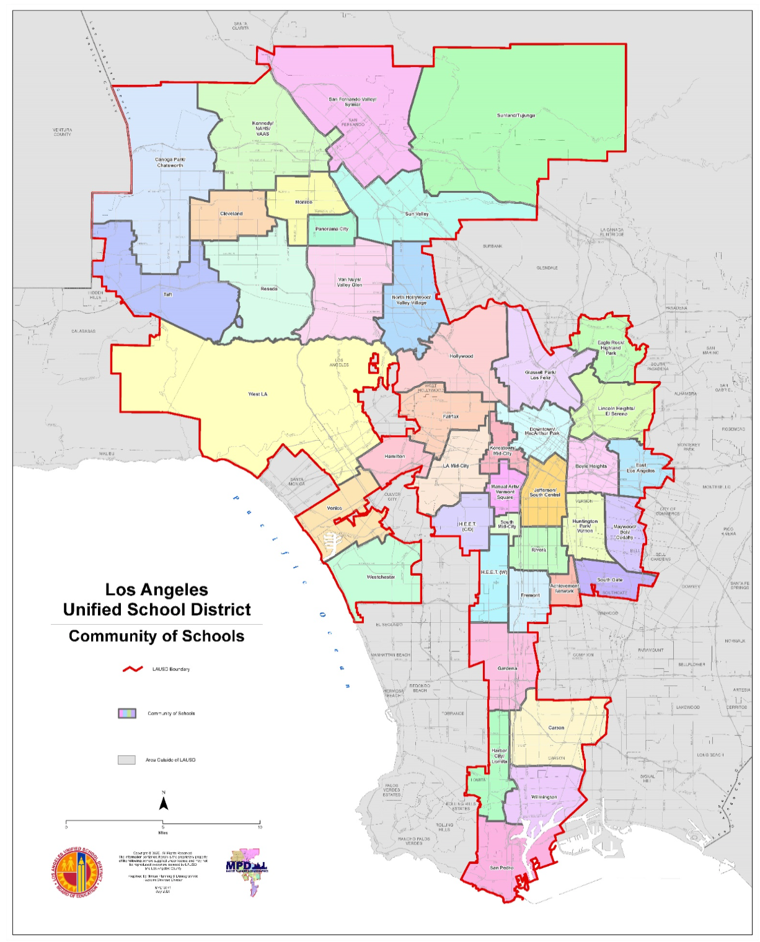
Goal: Equitable Reopening
LAUSD: Over 1,000 facilities (850 elementary, middle, and high schools) including early care and education, and adult education
Started reopening April 2021.
~500,000 elementary, middle, and high school students, 80% economically disadvantaged
Distance learning gap during COVID-19:
At start of closures, 1 in 4 children in LA County lacked technology resources for distance learning
Only about half of the families in lowest household income quintile had a desktop/laptop and residential broadband
Adjusted case rates
Notes:
In particular, we were focused on our local public school system, the Los Angeles Unified School District,
which is the second largest district in the country and serves about half a million students.
More than 80% of these students are economically disadvantaged,
and many of these students didn’t have reliable access to a computer and an internet connection suitable for online learning.
As a result, it was very important to enable these students to return to classrooms as soon as it’s safe to do so.
However, many of these students also live in households with family members who were at high risk for serious COVID complications

Slide 4
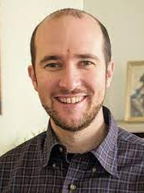





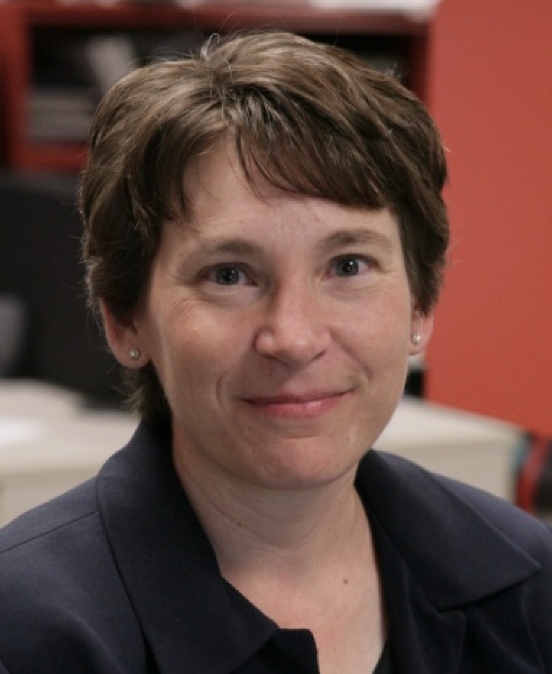
Team Science: UCLA CTSI Population Health Program
Ezra Morrison
Roch Nianogo
Vlad Manuel
Onyebuchi Arah
Nathaniel Anderson
Tony Kuo
Moira Inkelas
Notes:
During my postdoc at UCLA, I was part of a Population Health team that has been working with the Los Angeles school district to support their Covid management efforts.
This was a large team effort, and you can see here our full group of research collaborators.
https://ctsi.ucla.edu/overview/pages/pophealth-homepage

Slide 5
Research Questions
“How often should we do surveillance testing of our students?”
“What fraction of students should we test in each sample?”
“What steps should we take when students or their parents report symptoms or exposures?”
“Would it be helpful to devote resources to educating families about COVID safety and accurate exposure reporting?”
“If one or a few students in a classroom test positive, should we quarantine the whole classroom?”
“How important is it to ensure that students stay social-distanced and keep their masks on?”
“Can they eat lunch together in small groups?”
Notes:
As part of an ongoing collaboration with LAUSD, we decided to develop an epidemiological model for in-person instruction.
This model was meant to help the district think about questions such as,

Slide 6
Modeling Objectives
Models enable stakeholders to state their assumptions and gain insight into how local conditions and mitigation efforts might influence key outcomes. They can:
  Prior to reopening, represent how the system will operate:
    Clarify goals, dynamics of the LA Unified program
    Surface important elements of strategy, impact, interdependencies
    Inform decisions on testing platforms
    Identify data that needs to be more precise
  Once the system is operating, inform decisions:
    Set quantity, frequency of testing to achieve desired outcomes
    Inform other questions as the pandemic evolves
Notes:
The guiding motivation behind this model was a collective recognition that
It’s critical to synthesize and visualize information and data about
the various factors and interactions that could affect student and staff risk and safety,
so that reasonable plans can be developed and put in place to reopen schools in LA.
Some of how this modeling effort could inform the process include
- Prior to reopening, representing how the system will operate
- Once the system is operating, informing decisions about changes to testing protocols and other policies

Slide 7
Conceptual Model
C
O
M
M
U
N
I
T
Y
P
A
R
T
N
E
R
S
H
I
P
(
P
r
e
v
e
n
t
i
v
e
a
c
t
i
o
n
s
)
I
n
c
r
e
a
s
e
s
a
f
e
r
a
c
t
i
o
n
s
a
t
h
o
m
e
I
n
c
r
e
a
s
e
s
a
f
e
r
a
c
t
i
o
n
s
i
n
s
c
h
o
o
l
O
p
t
i
m
i
z
e
b
e
h
a
v
i
o
r
&
m
i
t
i
g
a
t
i
o
n
:
S
t
a
b
l
e
n
u
m
b
e
r
o
f
,
a
n
d
k
n
o
w
B
n
a
s
e
l
i
n
e
R
e
-
e
n
t
r
y
O
n
g
o
i
n
g
c
l
o
s
e
c
o
n
t
a
c
t
s
D
i
s
t
a
n
c
i
n
D
g
a
i
l
E
y
x
p
o
s
u
r
e
r
i
s
k
s
,
P
e
r
i
o
d
i
R
c
a
t
e
o
f
s
a
f
e
r
h
o
m
e
F
a
c
i
a
l
c
o
v
e
r
i
n
e
g
x
p
o
s
u
r
e
o
b
r
e
h
a
v
i
o
r
s
,
I
n
f
e
c
t
i
o
n
c
o
n
t
r
o
R
l
e
p
o
r
t
e
d
P
o
s
i
t
i
v
s
e
y
m
p
t
o
m
s
e
,
x
p
o
s
u
r
e
r
i
s
k
s
,
e
x
p
o
s
u
r
e
o
r
C
O
V
I
D
-
1
a
9
n
d
/
o
r
p
o
s
i
t
i
v
k
e
n
o
w
n
e
x
p
o
s
u
r
e
o
r
+
s
y
m
p
t
o
m
s
t
e
s
C
t
O
V
I
D
-
1
9
t
e
s
t
s
?
y
m
p
t
o
m
s
,
a
n
d
A
d
j
u
s
t
s
c
h
o
o
l
t
e
s
t
i
n
g
,
C
O
V
I
D
-
1
9
i
n
f
e
c
t
i
o
n
c
o
n
t
r
o
l
,
a
n
d
e
d
u
c
a
t
i
o
n
a
s
i
n
d
i
c
a
t
e
N
d
o
s
y
m
p
t
o
m
s
,
N
o
s
y
m
p
t
o
m
s
,
n
o
e
x
p
o
s
u
r
e
,
a
n
d
n
o
e
x
p
o
s
u
r
e
N
e
g
a
t
i
v
e
t
e
s
n
t
e
g
a
t
i
v
e
t
e
s
t
C
a
m
p
u
s
P
u
b
l
i
c
h
e
a
l
t
e
h
n
t
r
y
c
o
n
t
a
c
S
t
y
m
p
t
o
m
s
,
C
e
n
t
r
a
l
i
z
e
e
x
p
o
s
u
r
e
s
,
S
y
m
p
t
o
m
s
o
r
t
r
a
c
i
n
P
g
o
s
i
t
i
v
e
t
e
s
t
k
n
o
w
l
e
d
g
e
f
o
a
r
n
d
/
o
r
p
o
s
i
t
i
v
e
t
e
s
t
e
x
p
o
s
u
r
e
a
n
a
l
y
t
i
c
s
,
l
e
a
r
n
i
n
g
,
C
O
M
M
U
N
I
T
Y
E
N
G
A
G
E
M
E
N
T
R
e
s
p
o
n
d
t
o
e
x
p
o
s
u
r
e
/
s
y
m
p
t
o
m
s
a
n
d
r
e
d
u
c
e
i
n
-
s
c
h
o
o
l
t
r
a
n
s
m
i
s
s
i
o
n
m
o
d
e
l
i
n
g
Identify support needs when exposure or symptoms reported
C
a
s
e
m
a
n
a
g
e
m
e
n
t
I
d
e
n
t
i
f
y
h
o
m
e
T
a
r
g
e
t
e
d
t
e
s
t
i
n
g
I
s
o
l
a
t
i
o
n
a
n
d
t
o
d
e
v
e
l
o
p
s
a
f
e
r
a
n
d
s
c
h
o
o
l
o
f
i
n
d
i
v
i
d
u
a
l
s
q
u
a
r
a
n
t
i
n
e
h
o
m
e
p
l
a
n
s
c
o
n
t
a
c
t
s
a
n
d
h
o
u
s
e
h
o
l
d
s
g
u
i
d
a
n
c
e
Notes:
We started with this conceptual model of what a reopening strategy might look like.
One of the key elements of this conceptual model was the idea that we would require daily self-reports of symptoms and exposures from students and their parents prior to
Allowing them to enter campus. This system is being implemented by LAUSD, and we thought it would be particularly important to get self-reports not only from the students
But also their parents, because if the parent becomes symptomatic, that gives us an early warning that the student might be about to be infected. We know that many students
won’t show symptoms and if they do it might be after they have already been contagious for a day or two. So at that point it is too late to completely prevent them from infecting their classmates.
But if the students are being by their parents and we can detect the parents’ symptoms early enough, we might have a head start that allows us to get the student into quarantine before they become infectious.
Another key aspect of our conceptual model is the idea of community engagement; when families report symptoms or exposures, we want to follow with them to check that what they are experiencing are actually
COVID symptoms, and also to talk about ways they might reduce their risks going forward.

Slide 8

What are agent-based models?
Longitudinal
Multiple “agents”
  People
  Hospitals
  Schools
  Governments
Agents “act”
Agents “interact”
Notes:
We wanted to develop a quantitative simulation model of what such a reopening scenario.
Specifically, we decided to build what’s called an agent-based model.
If you’re not familiar with agent-based models, they are quantitative simulations in which we create representations of
the individuals in a community and then simulate aspects of their day-to-day lives to see what happens to them over time
under various conditions.
Basically, the Sims, but usually with much worse graphics.
Longitudinal: they model how things change over time
Agents don’t need to be human, or even alive; could include locations, corporations, etc, as long as the state or behavior of one entity affects others.
SimCity is also an agent-based model.
Very different from the usual independence assumptions.
Whether I get a vaccine might depend on what I see other individuals doing
Also: what’s a model?
ABMs extend microsimulations
Not the same kind of interaction as in regression; the ABM kind is also sometimes called “Interference”
A model is an informative representation of an object, person or system. (https://en.wikipedia.org/wiki/Model)

Slide 9
Types of interactions
Physical
  Pathogen transmission
  Violence
  Cooperation
Social
  Sharing information
  Socializing
  Encouraging or inhibiting others’ behaviors
    Alcohol, tobacco, other drug use

Slide 10
Emergent behaviors
ABMs evolve according to rules specifying how agents behave, relate with each other, and interact with the simulated environment
Models with simple rules governing agent behavior can result in complex, unanticipated population-level outcomes

Slide 11
Uses of agent-based models
Purpose of the Model
  Observational
    Understanding causal mechanisms
    Forecasting disease burden
  Interventional
    Evaluating the impact an intervention or policy
Use of Data
  Stylized: generate hypotheses
  Empirical: test hypotheses

Slide 12
Our Model
Exogenous risks (social, errands, work)
Agents:
  Students
  Parents
  Teachers*
Behaviors:
  move between school, work, home
  experience symptoms
  get tested
  enter, exit quarantine
Individuals in proximity to each other can interact, i.e., infect each other
Measure outcomes: infection rates, instruction days missed
Parent
Parent
Parent
Parent
Student
Student
Teacher
Teacher
Susceptible
Symptoms or exposure reported
Exposed
Temporary quarantine
Infectious
Follow-up call
Recovered
Diagnostic testing
Safety education
Negative: return to school
Positive: extend quarantine
Reduce risk, increase reporting accuracy
Notes:
In this case, the individuals we are simulating are students, parents, and teachers, and their behaviors include moving between school,
work, and home, possibly getting exposed to COVID in each of these locations, reporting their symptoms, and undergoing diagnostic tests,
either in response to symptoms or as part of periodic epidemiological surveillance testing. If they show symptoms or get diagnosed with COVID,
they go into quarantine for a protocol-determined length of time.
The key element to an agent-based model is that individuals in proximity to each other can interact – specifically, in our case, they can
infect each other with COVID.
In our current implementation, we assume teachers are all fully vaccinated and can neither infect nor be infected; so for our purposes
we haven’t actually simulated them or assessed their outcomes; we are focused on the students and their families.
This assumption reflects the current situation in our local school district;
however, that situation might change as vaccine-resistant strains become more common or if we want to apply this model to other districts
Where vaccination is less widespread.
Getting back to our model: we simulate students and parents over time, and we can count how many of them have been infected at each time point.
We can also track the number of transmissions that occur in-school, and we can count the number of days of school that each student misses due to being quarantined,
either because they themselves have a COVID diagnosis, or because someone near them had COVID and they were quarantined pre-emptively.
One of the key elements of this model was the idea that we would require daily self-reports of symptoms and exposures from students and their parents prior to
Allowing them to enter campus. This system was implemented by LAUSD, and we thought it would be particularly important to get self-reports not only from the students
But also their parents, because if the parent becomes symptomatic, that gives us an early warning that the student might be about to be infected. We know that many students
won’t show symptoms and if they do it might be after they have already been contagious for a day or two. So at that point it is too late to completely prevent them from infecting their classmates.
But if the students are being by their parents and we can detect the parents’ symptoms early enough, we might have a head start that allows us to get the student into quarantine before they become infectious.
Another key aspect of our model is the idea of community engagement; when families report symptoms or exposures, we want to follow with them to check that what they are experiencing are actually
COVID symptoms, and also to talk about ways they might reduce their risks going forward.

Slide 13
Implementation Details
Initial conditions: past, current infections; vaccination; baseline testing
Daily event sequence
  COVID test results
  Students, parents self-report symptoms, exposures
  Students get tested
  On-campus transmissions
  Exogenous exposures
  Household transmissions
  Educational outreach
  Follow-up testing scheduled
Notes:
Test results trigger quarantines of individual students and possibly whole classrooms

Slide 14
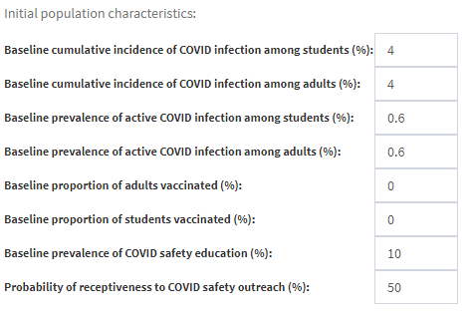
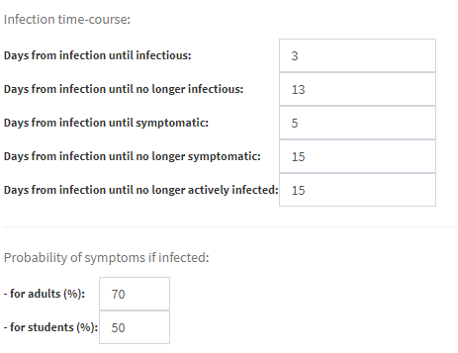
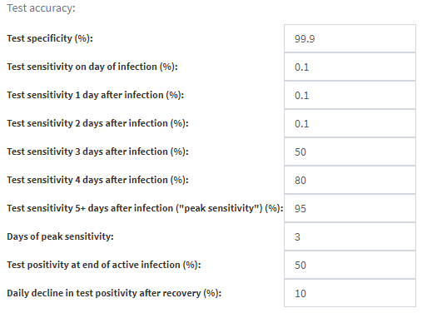
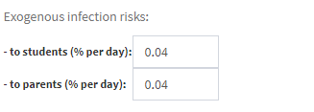
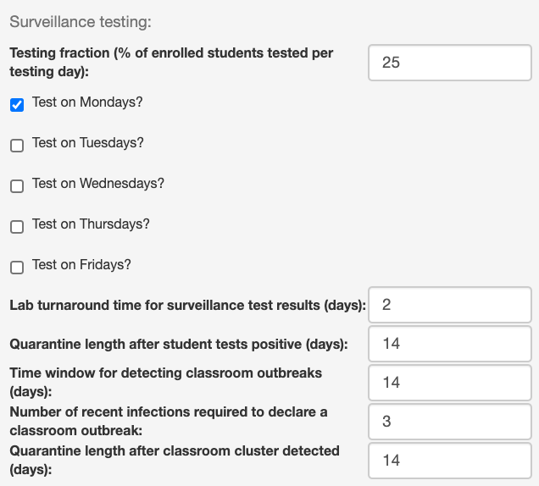
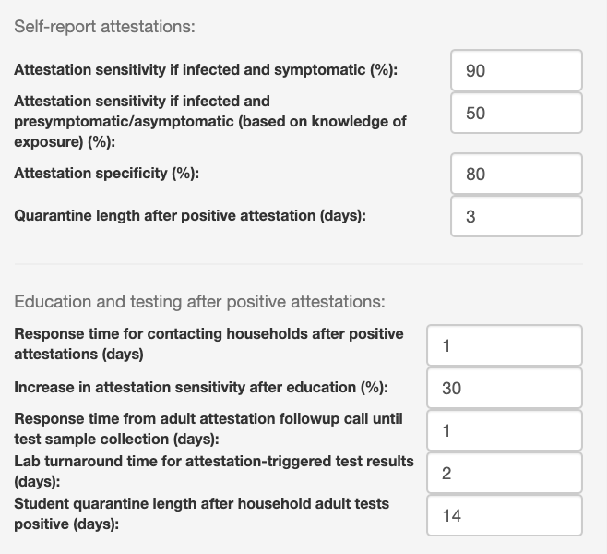
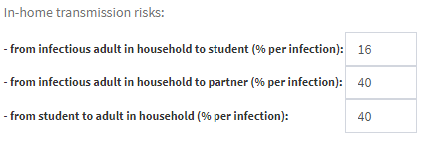

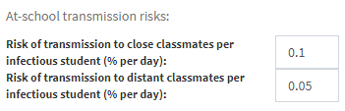
User Interface: Specifying Assumptions
Local conditions
Virus dynamics
Test accuracy
Mitigation
policies
bit.ly/em-abm
Notes:
As you might imagine, this model requires a lot of assumptions; specifically, our current version has 55 input parameters in total.
They are divided into four groups:
Local epidemic conditions: community transmission, immunity levels
Virus dynamics: probability and timing of infectiousness and showing symptoms when infected
Testing properties: sensitivity, specificity, and turnaround time from collection to results
Mitigation policies: class size, surveillance testing protocols, safety education, and quarantines
What I’m showing on the screen here is a user interface for this model, that we built to allow anyone to specify their own assumptions about the
values of these parameters and then run the model to see what outcomes those parameters produce.
This user interface is online now,
Backup copy: https://demorrison.ucdavis.edu/school.epi.abm/

Slide 15
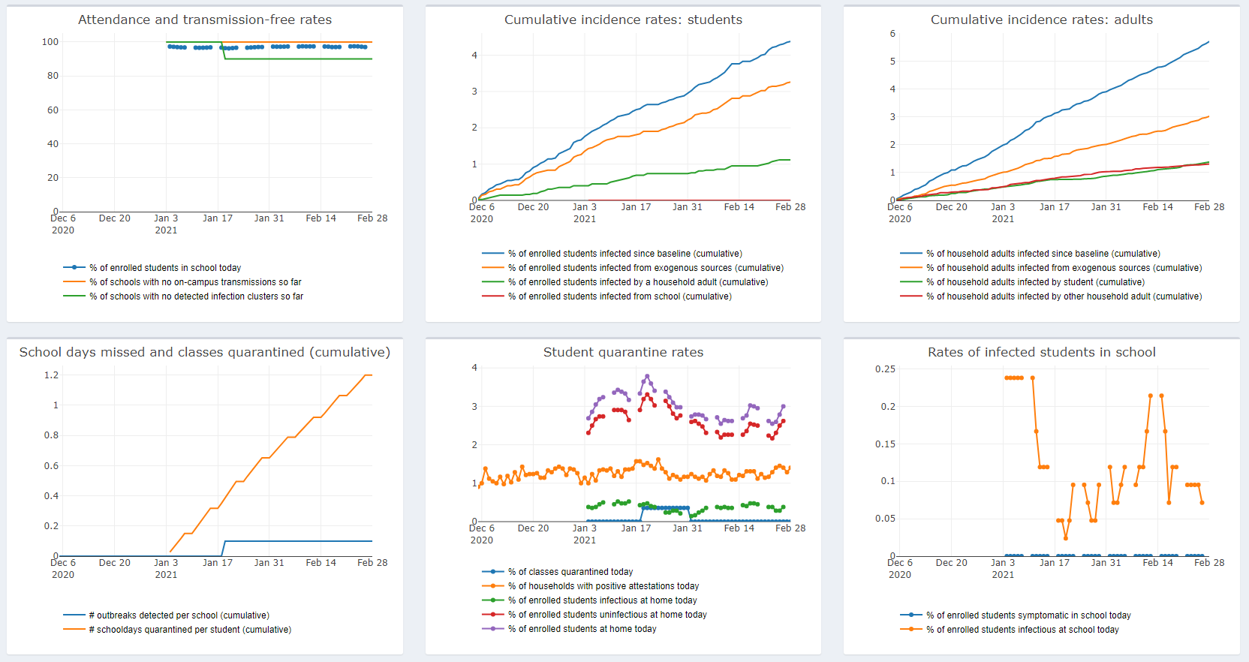
User Interface: Visualizing Outcome Trajectories
Notes:
Here’s an example of what the model’s outputs look like.
Unlike with the regression models that we studied in Epi 204, it usually isn’t possible to determine the distributions of the outcome variables directly from the model parameters.
Instead, we have to run these models on a computer, and see what happens. That’s called “simulation”. (Hence, the Sims)
You can see that we graph these outputs over time; the starting calendar date is arbitrary,
but it’s a parameter that users can change to help them visualize the time scale of these outcomes relative to whenever
they are planning to reopen the schools.

Slide 16
Adult Vaccination
Percentage of household adults vaccinated | % of enrolled students infected since baseline (cumulative)* | % of enrolled students infected from school (cumulative)* | # schooldays quarantined per student (cumulative)* | % of schools with no on-campus transmissions so far** | % of schools with no detected infection clusters so far**
0% (default) | 4.50 (2.62, 6.67) | 0.05 (0.00, 0.24) | 1.21 (0.91, 1.53) | 80.2% (79.4, 81.0) | 99.0% (98.7, 99.1)
25% | 4.15 (2.38, 6.19) | 0.06 (0.00, 0.48) | 1.06 (0.79, 1.35) | 79.5% (78.7, 80.3) | 98.9% (98.6, 99.1)
50% | 3.86 (2.14, 5.95) | 0.05 (0.00, 0.48) | 0.92 (0.69, 1.19) | 80.0% (79.3, 80.8) | 98.7% (98.5, 98.9)
75% | 3.58 (1.91, 5.48) | 0.06 (0.00, 0.48) | 0.79 (0.59, 1.03) | 78.8% (78.0, 79.6) | 99.0% (98.7, 99.1)
* 2.5% and 97.5% percentiles (across 10,000 simulated schools) are provided for student-level outcomes
** 95% exact binomial confidence intervals are provided for school-level outcomes
Notes:
And last, I want to show some of the analyses that we can perform using the model.
Starting from default assumptions about all of the parameters, we can vary one or several of them to see how those parameters
Affect outcomes, conditional on our assumptions for the other parameters.
For example, here we have run the model for four different levels of vaccination rates among parents, and we can see that
Students’ infection rates are actually not strongly affected by parents’ vaccination rates, given our other assumptions.
However, one outcome that does change is the the number of schooldays missed; the higher the vaccination levels, the fewer the school days missed,
Which makes sense because in our model, students are kept home whenever their parents report symptoms.

Slide 17
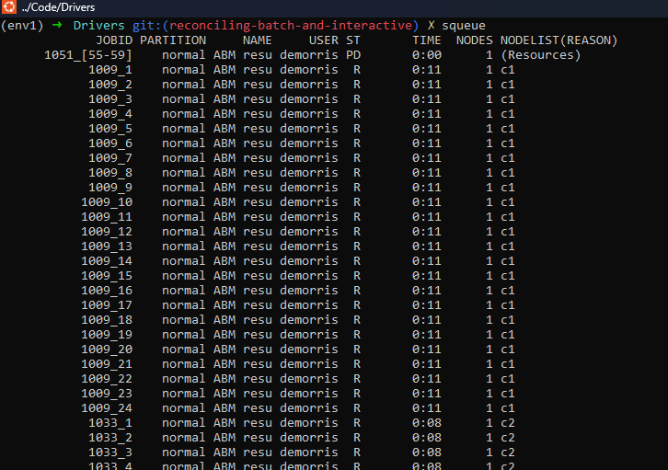
Cluster Computing
Notes:
Farm cluster is available: https://hpc.ucdavis.edu/

Slide 18
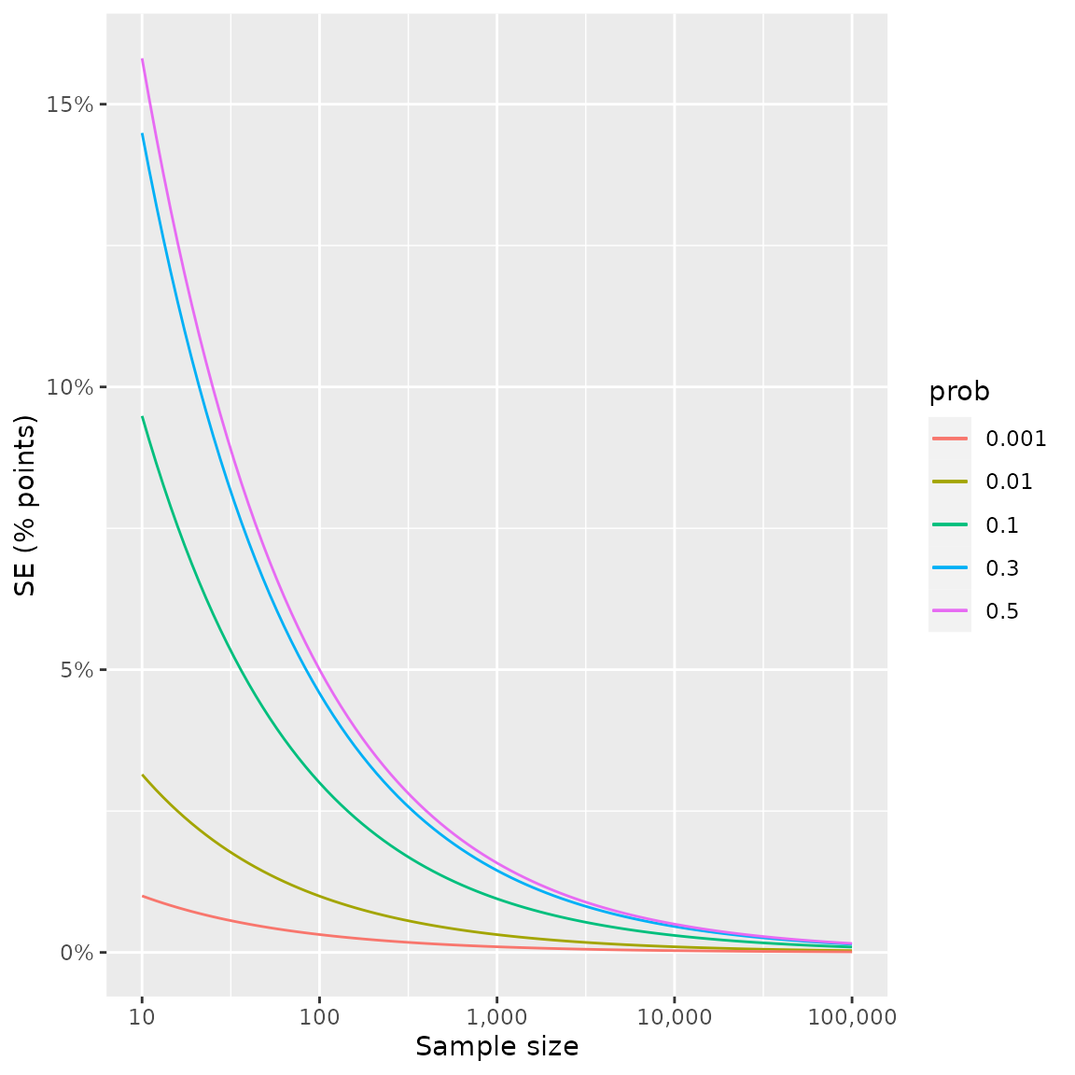
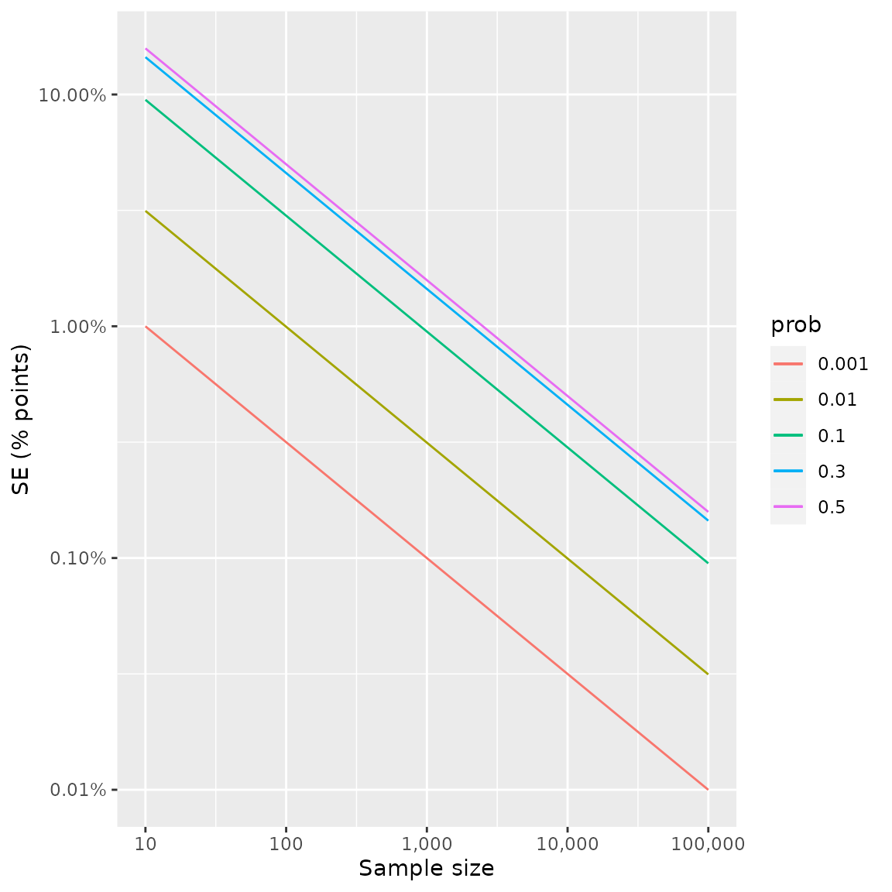
Simulation Sample Size

Slide 19
Class Size
Number of students per class | % of enrolled students infected since baseline (cumulative) | % of enrolled students infected from school (cumulative) | # schooldays quarantined per student (cumulative) | % of schools with no on-campus transmissions so far | % of schools with no detected infection clusters so far
10 | 4.48 (2.62, 6.43) | 0.04 (0.00, 0.24) | 1.21 (0.91, 1.53) | 84.2% (83.5, 84.9) | 99.3% (99.1, 99.5)
15 (default) | 4.50 (2.62, 6.67) | 0.05 (0.00, 0.24) | 1.21 (0.91, 1.53) | 80.2% (79.4, 81.0) | 99.0% (98.7, 99.1)
20 | 4.51 (2.62, 6.67) | 0.06 (0.00, 0.48) | 1.21 (0.92, 1.56) | 76.9% (76.1, 77.7) | 98.0% (97.7, 98.3)
30 | 4.53 (2.62, 6.67) | 0.09 (0.00, 0.48) | 1.24 (0.92, 1.83) | 69.3% (68.4, 70.3) | 94.8% (94.3, 95.2)

Slide 20
Transmission Risk
risk per infected distant contact | % of enrolled students infected since baseline (cumulative) | % of enrolled students infected from school (cumulative) | # schooldays quarantined per student (cumulative) | % of schools with no on-campus transmissions so far | % of schools with no detected infection clusters so far
0% (no risk) | 4.46 (2.62, 6.43) | 0.02 (0.00, 0.24) | 1.20 (0.91, 1.53) | 92.5% (92.0, 93.0) | 99.0% (98.8, 99.2)
0.01% | 4.47 (2.62, 6.67) | 0.03 (0.00, 0.24) | 1.20 (0.92, 1.53) | 89.6% (88.9, 90.2) | 99.0% (98.8, 99.2)
0.05% (default) | 4.50 (2.62, 6.67) | 0.05 (0.00, 0.24) | 1.21 (0.91, 1.53) | 80.2% (79.4, 81.0) | 99.0% (98.7, 99.1)
0.10% | 4.53 (2.62, 6.67) | 0.09 (0.00, 0.48) | 1.21 (0.92, 1.55) | 70.7% (69.8, 71.6) | 98.4% (98.1, 98.6)
0.50% | 4.82 (2.62, 7.14) | 0.39 (0.00, 1.43) | 1.25 (0.93, 1.66) | 27.8% (26.9, 28.7) | 91.9% (91.4, 92.5)
1.00% | 5.27 (2.86, 8.33) | 0.84 (0.00, 2.38) | 1.33 (0.95, 1.87) | 12.0% (11.4, 12.7) | 75.3% (74.5, 76.2)
Notes:
Here’s another example analysis. This time, we’re varying the risk of infection per infectious classmate. This parameter is meant to represent the combined effects of consistent mask wearing,
sufficient physical distancing, and ventilation. It allows the model can represent, for example, a different risk for a special needs classroom or a school where certain conditions increase the risk of transmission.
As you might expect, changes in this parameter have strong effects on the in-school infection rates, which are quantified in the second and fourth columns.

Slide 21
Testing Frequency and Sampling Fraction
Sampling fraction | Surveillance testing schedule | % of enrolled students infected since baseline (cumulative) | % of enrolled students infected from school (cumulative) | # schooldays quarantined per student (cumulative) | % of schools with no on-campus transmissions so far | % of schools with no detected infection clusters so far
0% | No surveillance testing | 4.49 (2.62, 6.67) | 0.06 (0.00, 0.48) | 1.18 (0.89, 1.49) | 79.2% (78.4, 80.0) | 99.5% (99.4, 99.7)
25% | Once a week (M) (default) | 4.50 (2.62, 6.67) | 0.05 (0.00, 0.24) | 1.21 (0.91, 1.53) | 80.2% (79.4, 81.0) | 99.0% (98.7, 99.1)
 | Twice a week (M/Th) | 4.50 (2.62, 6.67) | 0.05 (0.00, 0.24) | 1.23 (0.94, 1.58) | 81.3% (80.6, 82.1) | 97.9% (97.6, 98.1)
 | 3x a week (MWF) | 4.48 (2.62, 6.67) | 0.05 (0.00, 0.24) | 1.25 (0.95, 1.61) | 83.0% (82.3, 83.8) | 96.8% (96.4, 97.1)
 | Every weekday (M-F) | 4.49 (2.62, 6.67) | 0.04 (0.00, 0.24) | 1.30 (0.99, 1.68) | 84.2% (83.5, 84.9) | 94.5% (94.1, 95.0)
100% | Once a week (M) | 4.49 (2.62, 6.67) | 0.04 (0.00, 0.24) | 1.28 (0.97, 1.65) | 84.7% (84.0, 85.4) | 95.7% (95.3, 96.1)
 | Twice a week (M/Th) | 4.48 (2.62, 6.43) | 0.04 (0.00, 0.24) | 1.35 (1.02, 1.78) | 86.2% (85.5, 86.9) | 90.5% (89.9, 91.0)
 | 3x a week (MWF) | 4.47 (2.62, 6.43) | 0.03 (0.00, 0.24) | 1.43 (1.09, 1.90) | 87.7% (87.0, 88.3) | 83.9% (83.2, 84.6)
 | Every weekday (M-F) | 4.48 (2.62, 6.67) | 0.03 (0.00, 0.24) | 1.59 (1.20, 2.14) | 87.3% (86.7, 88.0) | 70.2% (69.3, 71.1)

Slide 22
Calibration and Validation
Is this a good model?
  Are the default parameter values accurate?
  Does it make good predictions?
Hard to assess at the time we developed this model
  Conditions changing rapidly
  Lots of data; but informative?
Notes:
Calibration: choosing parameters that produce accurate predictions on some training data (model fitting, training)
Validation: does this model make accurate predictions? (model testing)

Slide 23
Conclusions
Model surfaces dynamics, assumptions, questions:
  parameter values and model mechanics are visible, understandable to non-technical viewers
Adaptive modeling:
  parameter values should be easy for users to customize to current local conditions (community prevalence, availability and uptake of vaccination and testing)
Notes:
Ok, so that’s an overview of the structure of our model and the kinds of questions it can help address.
Overall, we think this approach addresses our goals of providing a transparent and adaptable model that can help policymakers who are planning school reopenings.

Slide 24
Morrison et al, Frontiers in Public Health 2023:
https://doi.org/10.3389/fpubh.2023.856940
https://bit.ly/em-abm
https://github.com/UCLA-PHP/school.epi.abm
demorrison@ucdavis.edu
Notes:
If you’re interested in learning more, we have a manuscript preprint available on medRxiv, and as I mentioned we have an online user interface that you can access at the url on this slide or using the QR code. Or feel free to contact me directly at my email dmorrison01@ucla.edu.
https://demorrison.ucdavis.edu/school.epi.abm

Slide 25
Learn more about ABMs
Marshall, BDL, “Agent-Based Modeling”, Chapter 8 in El-Sayed AM, Galea S, ed. Systems science and population health. Oxford University Press; 2017.
Nianogo RA, Arah OA. “Agent-based modeling of noncommunicable diseases: a systematic review.” American journal of public health. 2015 Mar;105(3):e20-31.
Gilbert N. Agent-Based Models. Thousand Oaks, CA: SAGE Publications; 2008.
Railsback SF, Grimm V. Agent- based and individual- based modeling: A practical introduction. Princeton, NJ: Princeton University Press; 2012.
Notes:
https://www.coursera.org/learn/model-thinking
PSC 120— Agent-Based Modeling

Slide 26
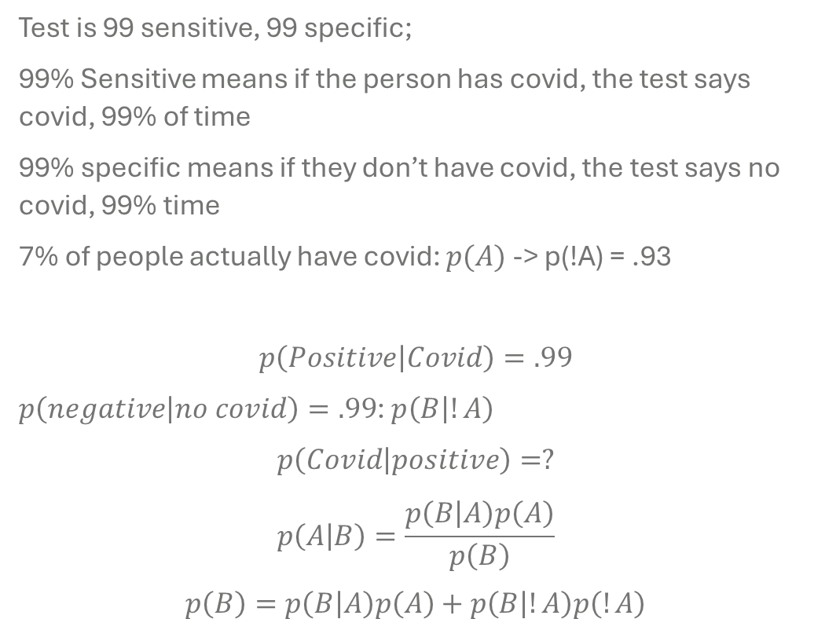
Test is 99 sensitive, 99 specific;
99% Sensitive means if the person has covid, the test says covid, 99% of time
99% specific means if they don’t have covid, the test says no covid, 99% time
7% of people actually have covid: $p(A)$ -> p(!A) = .93
$$p\left(Positive | Covid\right)=.99$$
$p\left(negative | no covid\right)=.99$: $p\left(B | !A\right)$
$$p\left(Covid | positive\right)=?$$
$$p\left(A | B\right)=\frac{p\left(B | A\right)p\left(A\right)}{p\left(B\right)}$$
$$p\left(B\right)=p\left(B | A\right)p\left(A\right)+p\left(B | !A\right)p\left(!A\right)$$

Slide 27
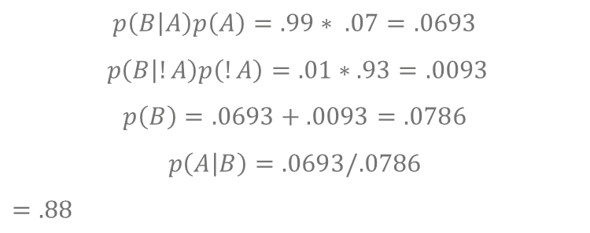
$$p\left(B | A\right)p\left(A\right)=.99∗ .07=.0693$$
$$p\left(B | !A\right)p\left(!A\right)=.01∗.93=.0093$$
$$p\left(B\right)=.0693+.0093=.0786$$
$$p\left(A | B\right)=.0693/.0786$$
$=.88$

